Slide 1



DIABETES PREDICTION WEB APP

Slide 2
TEAM MEMBERS:
L. LIKHITHA
P. LAHARI SAI
K. YAGNA PRIYA

Slide 3

INTRODUCTION
In understanding diabetes and how it develops, we need to understand what happens in the body.
Sugar (glucose) comes from the foods that we eat carbohydrate foods provide our body with its main energy source for everybody. When we eat carbohydrates, the body breaks them down into glucose. The glucose moves around the body in the bloodstream.
The remainder of the glucose is taken to the cells of our body for energy and also to our liver, where it is stored as energy that is used later by the body.

Slide 4

In order for the body to use glucose for energy, insulin is required. Insulin is a hormone that is produced by the beta cells in the pancreas. Insulin works like a key to a door.
Insulin attaches itself to doors on the cell, opening the door to allow glucose to move from the blood stream, through the door, and into the cell.
If the pancreas is not able to produce enough insulin or if the body cannot use the insulin it produces, glucose builds up in the bloodstream and diabetes develops.

Slide 5
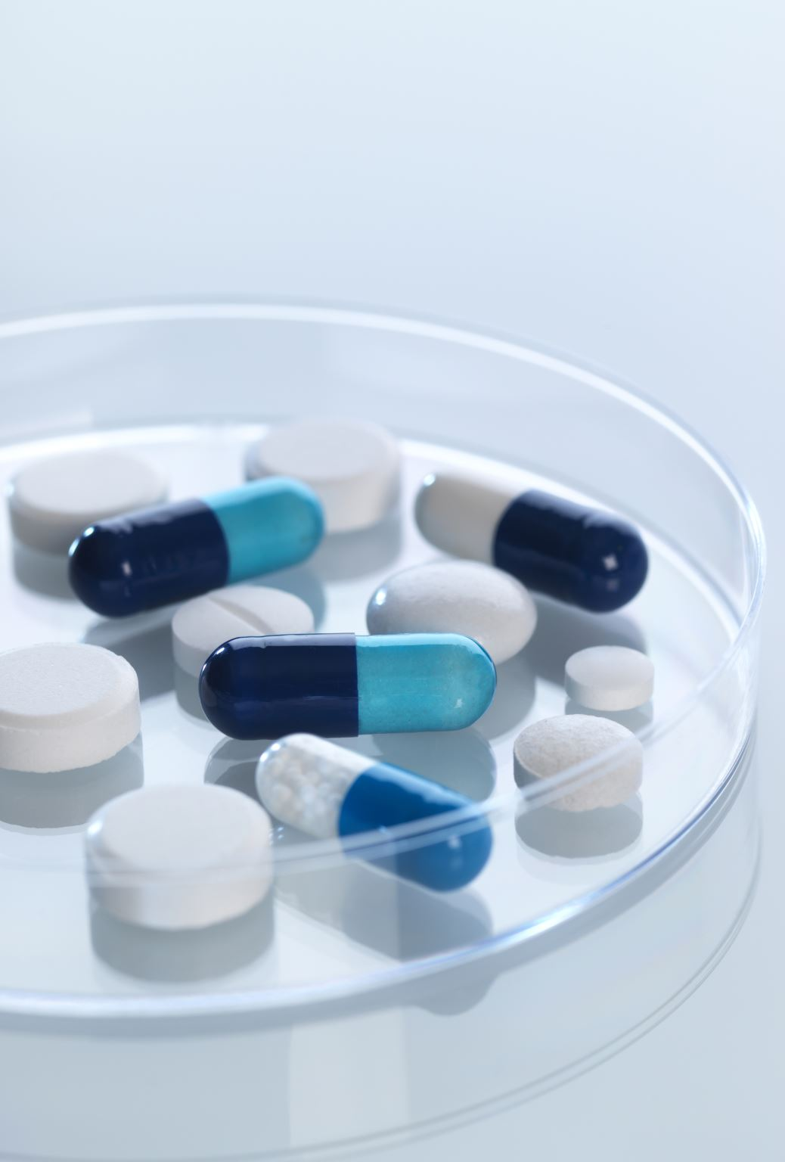
Types of Diabetes
Type 1 diabetes means that the immune system is compromised and the cells fail to produce insulin in sufficient amounts. There are no eloquent studies that prove the causes of type 1 diabetes and there are currently no known methods of prevention.
Type 2 diabetes means that the cells produce a low quantity of insulin or the body can’t use the insulin correctly. This is the most common type of diabetes, thus affecting 90% of persons diagnosed with diabetes. It is caused by both genetic factors and the manner of living.
Gestational diabetes appears in pregnant women who suddenly develop high blood sugar. In two thirds of the cases, it will reappear during subsequent pregnancies. There is a great chance that type

Slide 6
Literature survey
AUTHOR | TITLE | ALGORITHM
Sadhu, A. and Jadli A | Sadhu A, Jadli A Early-stage diabetes risk prediction:A comparative analysis of classification algorithms. | Experimented on a diabetes data set taken from the UCI repository. There were 520 occurrences and 16 attributes in all. They attempted to concentrate their efforts on predicting diabetes at an early stage.
Khanam | Khanam JJ, Foo SY A comparison of machine learning algorithms for diabetes prediction. | experimented with diabetes illness prediction. Diabetes is a condition with no known cure; therefore early detection is essential. In this study, data mining, ML techniques, and neural network (NN) methodologies were utilized to predict diabetes. They developed a technique that could accurately predict diabetes.
Julius | Julius AO, Ayokunle AO, Ibrahim FO Early diabetic risk prediction using machine learning classification techniques | The goal of this study was to use machine learning classification approaches based on observable sample attributes to predict diabetes at an early stage. The k-NN, SVM, functional tree (FT), and RFCs were employed as classifiers.

Slide 7

Software Components
•Windows 10/11
•Google Colab
•Anaconda
•Python

Slide 8

HARDWARE REQUIREMENTS
HARD DISK: 100 GB
RAM: 8 GB
SPEED: 2.6 GHZ
PROCESSOR: INTEL/AMD PROCESSOR

Slide 9
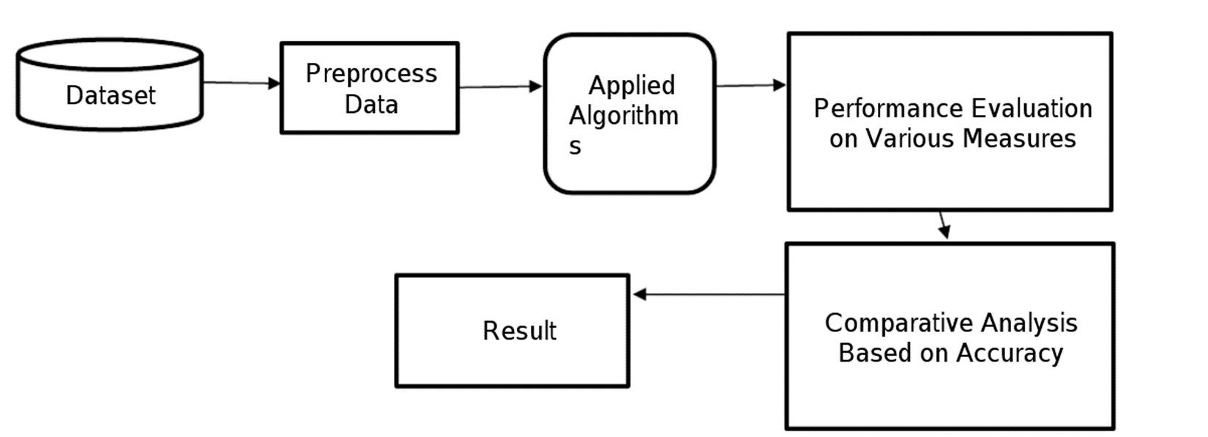
Data flow diagram

Slide 10
ALGORITHMS USED
K nearest neighbour
Logistic Regression
Support vector Machine
Decision tree

Slide 11
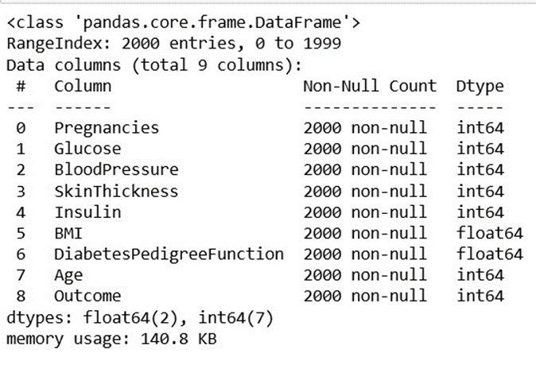
Dataset Description
The objective is to predict based on the measures to predict if the patient is diabetic or not.

Slide 12
Dataset description
Serial no | Attribute Names | Description
1 | Pregnancies | Number of times pregnant
2 | Glucose | Plasma glucose concentration
3 | Blood Pressure | Diastolic blood pressure
4 | Skin Thickness | Triceps skin fold thickness (mm)
5 | Insulin | 2-h serum insulin
6 | BMI | Body mass index
7 | Diabetes pedigree function | Diabetes pedigree function
8 | Age | Age of patient
9 | Outcome | Class variable (0 or 1)

Slide 13

Modules
Numpy – used for arrays
Pandas – used for reading datasets
Sklearn - used for machine learning and statistical modeling including classification, regression, clustering
Pickle – allows for flexibility when deserializing objects

Slide 14
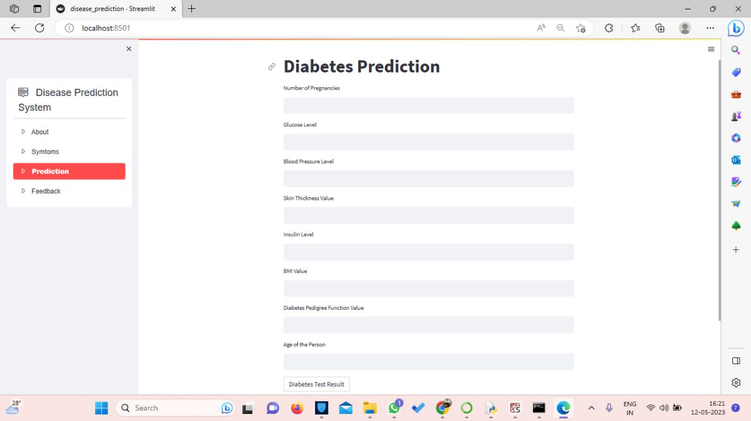
OUTPUT

Slide 15

CONCLUSION
In future, the designed system with the used machine learning classification algorithms can be used to predict or diagnose other diseases. The work can be extended and improved for the automation of diabetes analysis including some other machine learning algorithms.

Slide 16
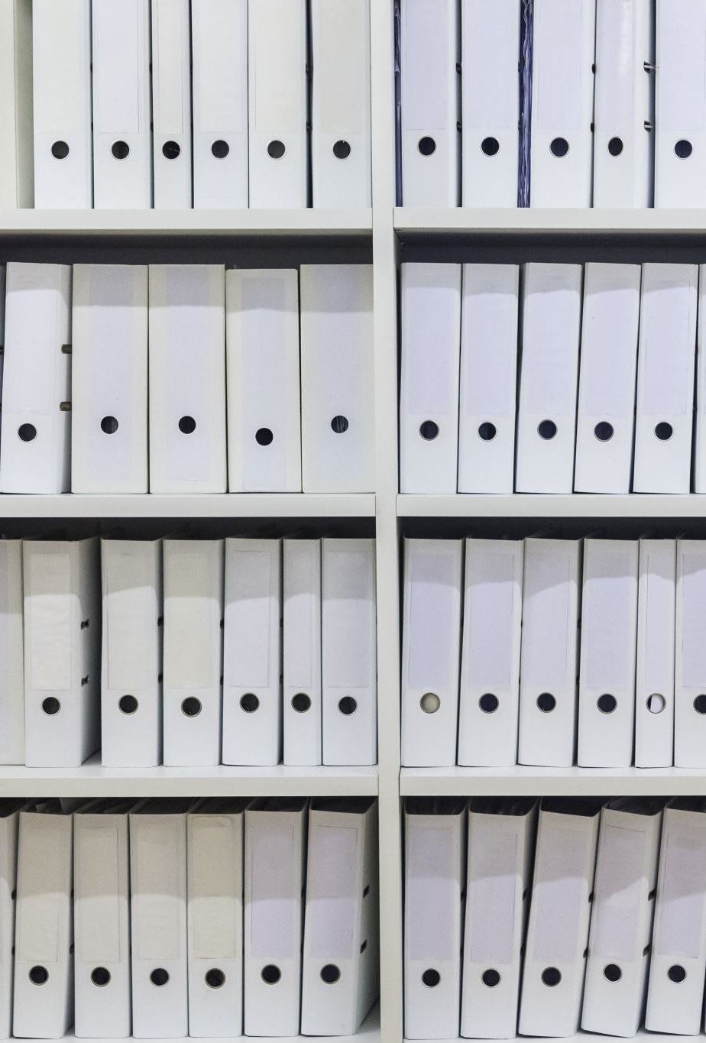
References
[1] Aljumah, A.A., Ahamad, M.G., Siddiqui, M.K., 2013. Application of data mining: Diabetes health care in young and old patients. Journal of King Saud University - Computer and Information Sciences 25, 127–136. doi:10.1016/j.jksuci.2012.10.003.
[2]. Arora, R., Suman, 2012. Comparative Analysis of Classification Algorithms on Different Datasets using WEKA. International Journal of Computer Applications 54, 21–25. doi:10.5120/8626-2492.
[3]. Bamnote, M.P., G.R., 2014. Design of Classifier for Detection of Diabetes Mellitus Using Genetic Programming. Advances in Intelligent Systems and Computing 1, 763–770. doi:10.1007/978-3319-11933-5.

Slide 17

THANK YOU

